Slide 1
Brio
Mallory Daly, Audrey Leung, Jili Liu,
Josie Sullivan, Minson Yen

Slide 2


Sarah & Mary
Taxing our relationship…
Eyes and mind not what they used to be…
Tech gadgets are a hassle…
Don’t want to use things that make me feel old...
Assisted care is expensive and having my own place is important to me...
Notes:
Customer and user needs

Slide 3
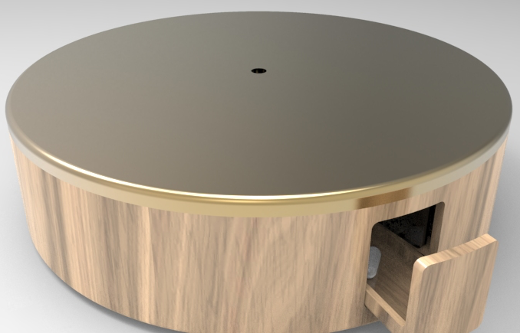
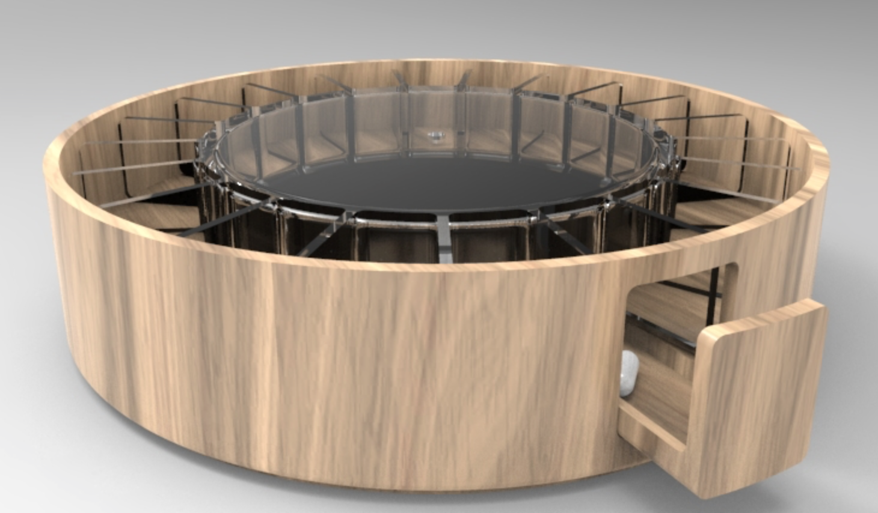
Brio
Purpose: Bringing medicine management back to the individual, lightening a caregiver’s load and improving family relationships
Notes:
Taxing our relationship…
Eyes not enough…
Tech gadgets are a hassle…
Don’t want to use things that make me feel old...
Care is expensive and having my own place is important to me...

Slide 4
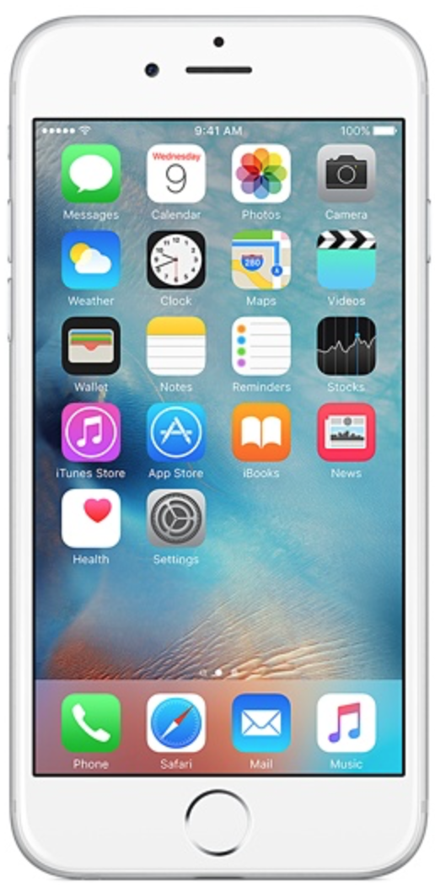
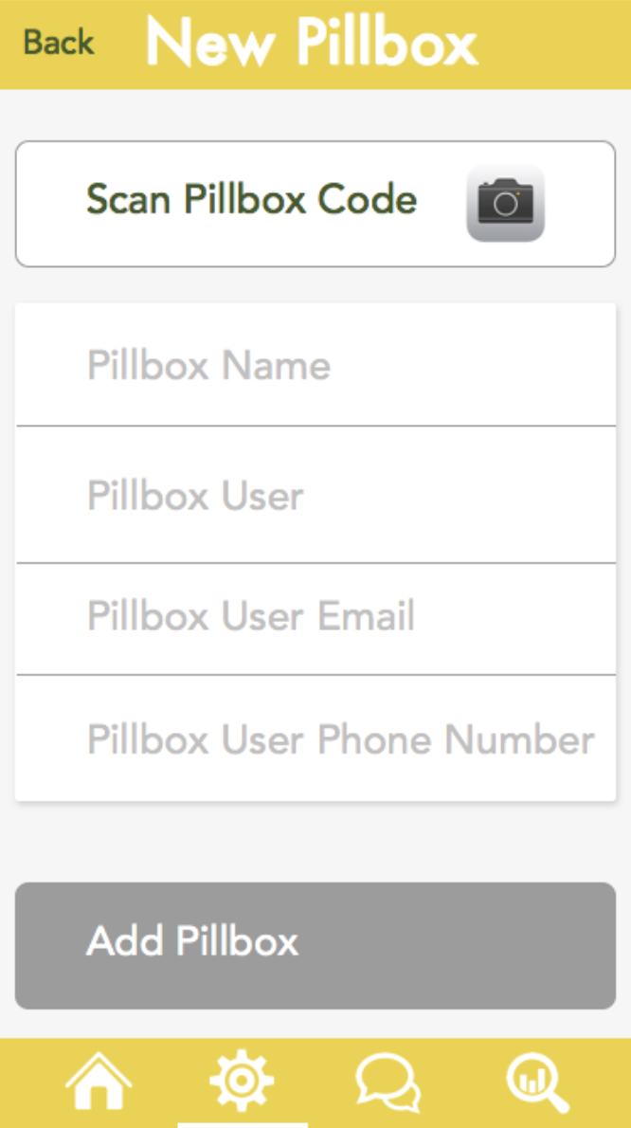
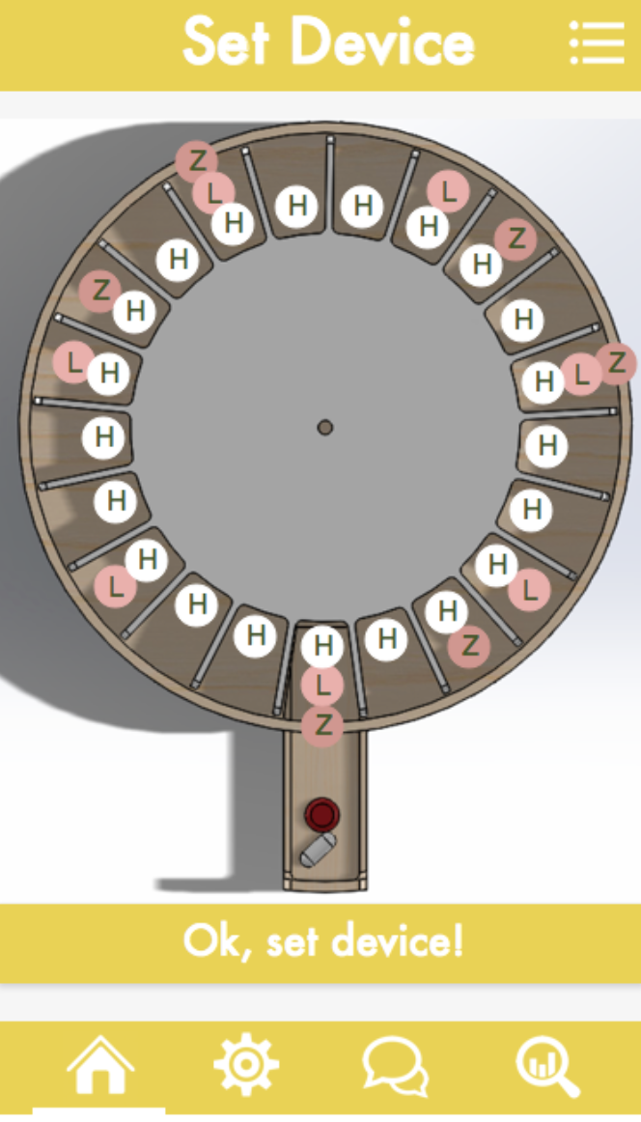
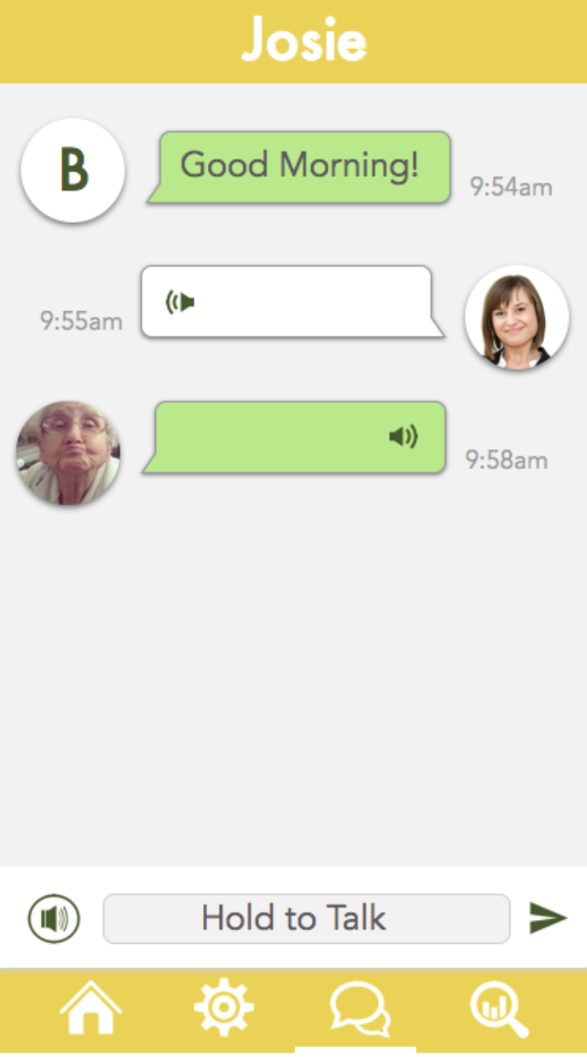
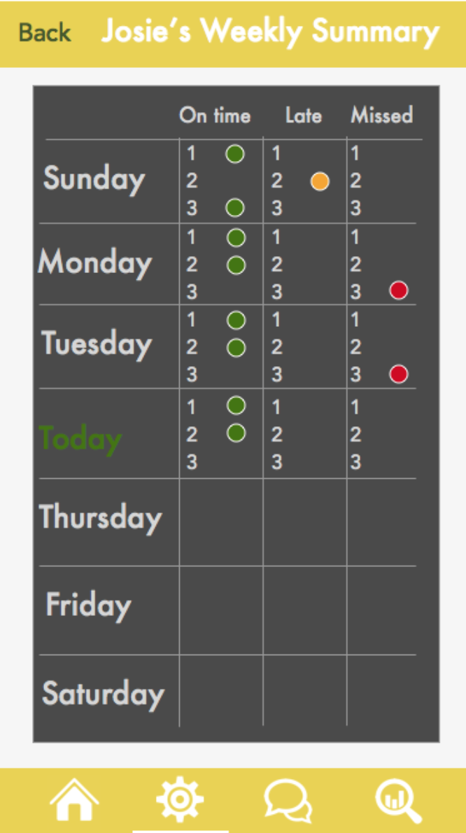
Chat with or without smart phones
Nag-less monitoring by caregivers
Simple setup
Auto dispenses

Slide 5
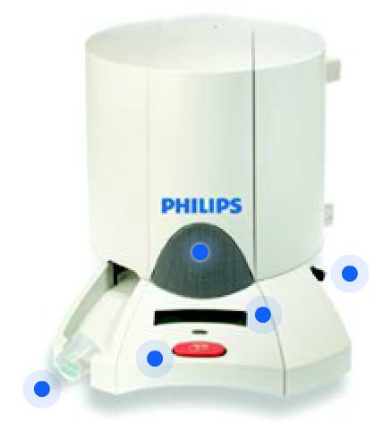
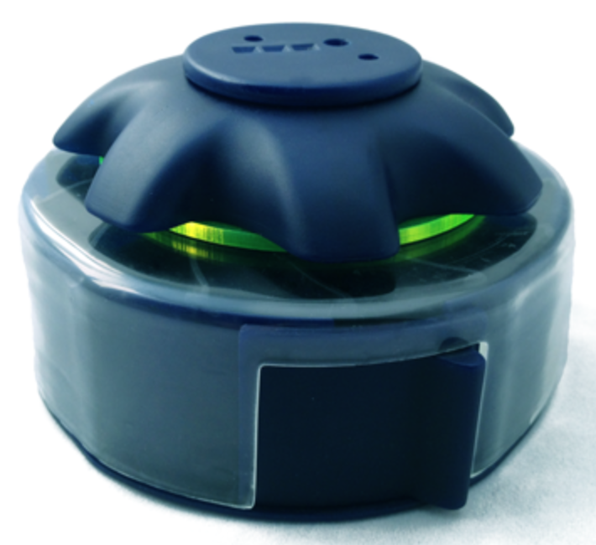

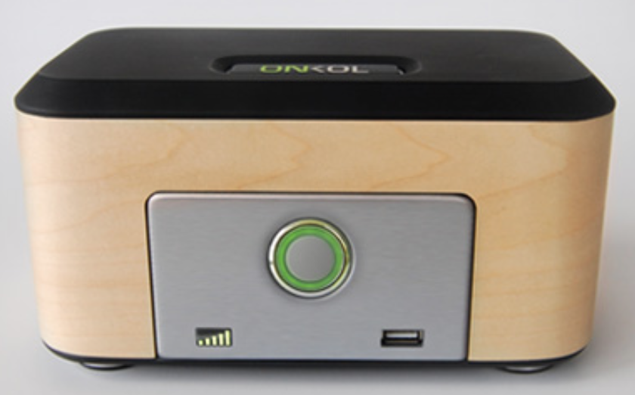











Brio
Competition – Other IOT devices miss core needs

Slide 6

Future Vision - Enhance Life for Older Adults
33-60% discrepancy between prescription versus what is taken by older adults
Size of this problem in the U.S. today:
800,000 individuals live alone in their home with
Alzheimer’s, expected to increase with Baby
Boomer generation
11% of hospital admissions for older adults
$14 billion to nursing homes annually
~$25,000 per year for full-time family member caregiver
Sources: National Center for Biotechnology Information, MetLife, NPR, Alzheimer's Association of America

